Slide 1
Research Design and Data Analysis
Eugene Brusilovskiy

Slide 2
What is Research Design?
“The research design refers to the overall strategy that you choose to integrate the different components of the study in a coherent and logical way, thereby, ensuring you will effectively address the research problem; it constitutes the blueprint for the collection, measurement, and analysis of data^{1,2}.”
“The function of a research design is to ensure that the evidence obtained enables you to effectively address the research problem logically and as unambiguously as possible.
In social sciences research, obtaining information relevant to the research problem generally entails specifying the type of evidence needed to test a theory, to evaluate a program, or to accurately describe and assess meaning related to an observable phenomenon³.”
¹ De Vaus, D. A. Research Design in Social Research. London: SAGE, 2001;
² Trochim, William M.K. Research Methods Knowledge Base. 2006.
³ De Vaus, D. A. Research Design in Social Research. London: SAGE, 2001.

Slide 3

Where It All Starts

Slide 4
We Will Discuss Several Types of Research Design
Experimental Design
Quasi-Experimental Design
Correlational Design
Disclaimer: This presentation is by no means intended to be comprehensive – it will provide a few types of research design that are frequently used in practice, and describe the types of questions that may be answered with each design and the types of statistical methods that can be used to analyze the data. In practice, there are many other types of research design and different ones require different analytical methods.

Slide 5
Experimental Design: Randomized Controlled Trial
Causal (i.e., experimental) research design provides a causal link between two variables (treatment and outcome)
E.g., treatment causes better outcomes
If we want to say that new treatment X caused outcome Y, we need to have:
Association (relationship) between X and Y. That is, our data would need to show that there is a statistically significant relationship between the new treatment and the better outcome.
Temporal precedence
If we want to say that the new treatment caused a better outcome, the treatment needs to have occurred prior to observing the outcome
Comparison group
We wouldn’t want to put all the study participants in just the treatment group: some would need receive the treatment, and some to be placed into a so-called control group, where they would not receive the new treatment
VERY IMPORTANTLY, Randomization
Individuals should be randomly assigned to the treatment or control groups.
And a few other things
Theoretical plausibility (http://www.tylervigen.com/spurious-correlations)
Dose-response
Consistency across studies
Very strong research design and intervention fidelity

Slide 6
What Is Achieved by Randomization?
Wikipedia puts it rather beautifully:
Random assignment “ensures that each participant or subject has an equal chance of being placed in any group. Random assignment of participants helps to ensure that any differences between and within the groups are not systematic at the outset of the experiment. Thus, any differences between groups recorded at the end of the experiment can be more confidently attributed to the experimental procedures or treatment.”
https://en.wikipedia.org/wiki/Random_assignment

Slide 7
Sample Scenario
Imagine we have a new program (treatment) to enhance community mobility among older adults and we would like to examine whether this new program is more effective than existing programs.
What is the treatment outcome (variable we’re measuring)?
Amount of time spent outside (in hours)
Type of outcome variable:
Time spent outside is a continuous variable
The best way to examine the effectiveness of a treatment is to do an experimental study, or a randomized controlled trial
One way to do this is to design a study where:
Half of the participants will be randomly assigned to the experimental condition, where they would get the new treatment, and
Half of the participants will be randomly assigned to the control condition, where they would receive the standard existing treatment
Notes:
Treatment: new program to enhance community mobility among older adults

Slide 8
Measurement
We need to measure the outcomes at (at least) two time points:
Right before treatment begins (at baseline)
Right after treatment ends (post-treatment)
What needs to happen in order for us to see that new program is more effective than standard treatment?
The amount of time spent outside should be:
The same in the experimental and control groups at baseline
Higher in the experimental group than in the control group at the post-treatment time point
The increase in amount of time spent outside from baseline to post-treatment should be higher in the experimental group

Slide 9
Statistical Analysis
Difference-in-differences approach: calculate the over-time differences (changes) for the experimental group and for the control group, and calculate the difference between these differences
 | EXPERIMENTAL
Subject | Baseline | Post-Intervention | Difference
1 | 7 | 9 | 2
2 | 5 | 6 | 1
3 | 8 | 8 | 0
4 | 7 | 6 | -1
5 | 9 | 16 | 7
6 | 2 | 6 | 4
7 | 0 | 1 | 1
8 | 1 | 2 | 1
9 | 4 | 4 | 0
10 | 3 | 8 | 5
AVERAGE | 4.6 | 6.6 | 2
 | CONTROL
Subject | Baseline | Post-Intervention | Difference
11 | 9 | 9 | 0
12 | 4 | 4 | 0
13 | 3 | 4 | 1
14 | 8 | 8 | 0
15 | 6 | 7 | 1
16 | 6 | 4 | -2
17 | 0 | 0 | 0
18 | 1 | 1 | 0
19 | 3 | 2 | -1
20 | 8 | 7 | -1
AVERAGE | 4.8 | 4.6 | -0.2

Slide 10
Statistical Analysis (Cont’d)
Is the over-time difference (change) in the experimental group higher than the over-time difference (change) in the control group?
On average, experimental group went up by 2 hours and control group went down by 0.2 hours (so the difference between groups is 2 – (-0.2) = 2.2 hours
Carry out an independent samples t-test to compare the average changes in each group
Test compares the average of a continuous (normally distributed) variable in the experimental group with the average in the control group.
We call it an independent samples test because the experimental and control groups constitute two separate, non-overlapping samples of individuals
 | Experimental Difference | Control Difference
1 | 2 | 0
2 | 1 | 0
3 | 0 | 1
4 | -1 | 0
5 | 7 | 1
6 | 4 | -2
7 | 1 | 0
8 | 1 | 0
9 | 0 | -1
10 | 5 | -1
AVERAGE | 2 | -0.2

Slide 11
A Different Scenario (3 time points)
We have a new program (treatment) to enhance community mobility among older adults and we would like to examine whether this new program is more effective than existing programs.
What is the treatment outcome (variable we’re measuring)?
Amount of time spent outside
When are we collecting measurements in the control and experimental groups?
At baseline, prior to the intervention (to make sure that randomization took care of any differences between the two groups)
Immediately post-treatment, (to see whether the experimental and control groups differ immediately after the intervention)
A month (6 months, 1 year, etc.) post-treatment (to see whether the effects of the intervention linger)
This is still an experimental study – we have two groups (treatment and control), and participants have been randomly assigned to each group

Slide 12
Statistical Analysis
The difference here is that we have 3 or more time points at which measurements are made
A statistical test called repeated measures ANOVA (analysis of variance) is used to compare the groups at all 3+ time points in terms of the average amount of time spent outside
 | EXPERIMENTAL
Subject | Baseline | Post-Intervention | 6 Months Post-Intervention
1 | 7 | 9 | 9
2 | 5 | 6 | 5
3 | 8 | 8 | 8
4 | 7 | 6 | 6
5 | 9 | 16 | 12
6 | 2 | 6 | 5
7 | 0 | 1 | 1
8 | 1 | 2 | 1
9 | 4 | 4 | 3
10 | 3 | 8 | 6
AVERAGE | 4.6 | 6.6 | 5.6
 | CONTROL
Subject | Baseline | Post-Intervention | 6 Months Post-Intervention
11 | 9 | 9 | 8
12 | 4 | 4 | 5
13 | 3 | 4 | 3
14 | 8 | 8 | 8
15 | 6 | 7 | 7
16 | 6 | 4 | 5
17 | 0 | 0 | 0
18 | 1 | 1 | 1
19 | 3 | 2 | 2
20 | 8 | 7 | 6
AVERAGE | 4.8 | 4.6 | 4.5

Slide 13
Example # 1 – Greening of Vacant Lots
Garvin, Cannuscio & Branas (2013): Greening vacant lots to reduce violent crime: a randomized controlled trial
There is some evidence that greening vacant lots is associated with reductions in crime
A RCT examining the effect of vacant lot greening on reported crime and perceptions of safety
Lots were randomly assigned to the greening (intervention) group and the control group
The greening intervention consisted of cleaning, planting grass & trees, and building a wooden fence around the perimeter of a lot
Administrative data were used to determine crime rates
Local resident interviews pre- and post- greening were used to assess perceptions of safety
Results showed that people around greened lots felt safer after greening than those around vacant lots in the control groups (p<0.01), but no significant group differences were reported in objective crime.

Slide 14
Example # 2 – Moving to Opportunity Intervention
Moving to Opportunity (MTO) is a major RCT sponsored by HUD
Since 1994, MTO provided 4,600 low-income families with children living in public housing in very disadvantaged urban neighborhoods a chance to move to private-market housing in much less distressed communities
Families were randomly assigned to one of 3 groups:
An MTO group that offered a housing voucher that could be used to move to a low-poverty (i.e., wealthier) neighborhood
Another MTO group that offered a traditional Section 8 housing voucher
A control group (no move)
Families were interviewed between 2008 and 2010 for the 10-15 year program evaluation

Slide 15
Example # 2 – Moving to Opportunity Intervention
Results of the MTO Intervention are below, for adults and youths.
Adults:
MTO improved physical and mental health
Adults in MTO groups had lower prevalence of obesity, diabetes, and fewer self-reported physical limitations than in the control group
Adults in MTO groups had lower levels of depression and psychological distress than in the control group
No difference between groups on hypertension and health-related risk behaviors
No difference between groups on economic self-sufficiency
Youths:
MTO had little to no effect on physical health
MTO improved mental health for females but not males
MTO had little impact on arrests
MTO had no detectable effects on math and reading achievement

Slide 16
Example # 3 – Internet Mental Health Intervention
Kaplan, Salzer, Solomon, Brusilovskiy & Cousounis (2011): Internet peer support for individuals with psychiatric disabilities: A randomized controlled trial
RCT sought to determine impact of unmoderated, unstructured Internet peer support for individuals with psychiatric disabilities
300 individuals with serious mental illnesses were randomized into one of 3 conditions:
Experimental Internet peer support via listserv
Experimental Internet peer support via an online bulletin board
Control group
Participants were interviewed at 3 time points – baseline, 4 months and 12 months post baseline
We found no over-time differences between the 3 groups on measures of recovery, quality of life, empowerment, social support or distress
Post hoc analyses showed that those who participated more in the listserv or the bulletin board discussions had greater distress than those with less participation

Slide 17
Some General Considerations
RCTs are expensive; they also require a sizable number of participants, and strong commitment (fidelity) to the intervention. Because of this, the intervention results should be generalizable, and the intervention applicable if carried out elsewhere.
For more information on when RCTs are suitable, please see Theodos, Simms, Brash, Sharygin & Emam (2014): Randomized Controlled Trials and Financial Capability: Why, When and How.
Sometimes, randomization isn’t appropriate or feasible
In some instances, it may not be ethical to randomize research participants
E.g., a study of a very promising new treatment for an otherwise lethal illness
In some instances, randomization might not be feasible (or very challenging)
E.g., examining the effect of tobacco smoke on nonsmokers
Only atypical participants may agree to participate in evaluation of some interventions
E.g., in faith-based interventions, a highly religious participants may have issues with being in a control group, whereas non-religious participants may not want to be in the experimental group where the faith-based intervention is delivered
For more information, see West et al. (2008): Alternatives to the Randomized Controlled Trial.

Slide 18

Source: www.causeweb.org

Slide 19
Quasi-Experimental Research Design (no randomization)
Let’s go back to our earlier example: imagine that we have our original problem: a new program (treatment) to enhance community mobility among older adults
We would still like to examine whether this new program is more effective than existing programs
However, in this study, participants haven’t been randomly placed into the experimental and control groups, so one of the key components of an experimental study is missing
With quasi-experimental studies like this one, it may not be possible to demonstrate a causal link between the treatment condition and the outcomes.
This is especially true if there are significant differences between the treatment and “control” groups at baseline.
Much of the analysis remains the same as with experimental studies: in our community mobility example, we can stick to difference-in-differences approach using an independent samples t-test if data are collected at two time points, and a repeated measures approach if data are collected at three or more time points.

Slide 20
Implications of Quasi-Experimental Designs
With quasi-experimental studies, it might not be possible to convincingly and definitively show that the treatment causes the outcome
A lack of randomization means that the groups aren’t necessarily equivalent at baseline
It may be possible to use statistical methods to control for baseline differences between groups
E.g., imagine that there are more males, whites and people over 75 in the treatment group.
We can control for these variables in our analyses, especially if we believe that they will be associated with our outcome variable.
Groups might still not be the same in other ways (e.g., on variables that weren’t measured) making it difficult to control for these differences
Relationship between treatment and outcome might be due to a confounding variable (variables that are related to both the treatment and the outcome and might be a plausible cause of the outcome)

Slide 21
Examples and Solutions
Imagine we have a situation where we have 2 groups (treatment and control) which are assessed at 2 time points.
Recall: if the 2 groups had been equivalent, we could have used a difference-in-differences approach to analyze the data – that is, we would have calculated the over-time change in our outcome variable in both groups, and compared the groups in terms of this change with an independent samples t-test
Let’s say our treatment and control groups are not equal on some of the variables at baseline
E.g., there are significantly more males in our treatment group, and people in the control group are significantly older
In this scenario, let’s say that age and gender are associated with our outcome variable, meaning that any between-group differences that we find post-intervention might be due to differences on these variables, rather than due to the treatment
However, since the groups are not equivalent we need to control for age and gender
If we only need to control for gender (categorical) we can do a test called a two-way ANOVA
If we only need to control for age (continuous) we can do a test called an ANCOVA (analysis of covariance) – which is mathematically equivalent to an OLS regression
Outcome is the dependent variable
Predictors are treatment (experimental vs. control) and age
If we need to control for a mix of categorical and continuous variables (gender and age), we would again do an ANCOVA
N.B.: If group membership is randomly assigned, as in experimental studies, groups should be equivalent, but there will be instances when randomization doesn’t work perfectly

Slide 22
Single Group Pre-Post Design
Imagine that we’re still measuring the effectiveness of a new treatment program, but we don’t have a control group
That is, everyone in sample gets the treatment, and we measure the amount of time they spend outside right before they participate in the program, and right after.
This may be considered another type of a quasi-experimental (some will call it pre-experimental) study that gives us pre-post data for our treatment group
We can use a statistical test called paired t-test to examine whether the average amount of time spent outside is higher at the second time point than at the first

Slide 23
Single Group Pre-Post Design (Cont’d)
In this sample, we observe that on average, people’s time outside increased by 2 hours after treatment.
But is this change significantly different from 0?
That is, how likely is it that this sample, where the over-time change is 2 hours, actually came from a population where the average over-time change is 0?
A paired t-test will be able to tell us.
Subtract the ‘Baseline’ score from the ‘Post-Intervention’ score to get the difference in scores.
Calculate the mean and s.d. of the difference.
If there is no change, we expect the mean of the difference to not be significantly different from 0.
If there is change, then we expect the mean difference to be significantly different from 0.
So this reduces to a 1 sample hypothesis test!
H0: μDifference = 0 vs. Ha: μDifference ≠ 0
 | EXPERIMENTAL
Subject | Baseline | Post-Intervention | Difference
1 | 7 | 9 | 2
2 | 5 | 6 | 1
3 | 8 | 8 | 0
4 | 7 | 6 | -1
5 | 9 | 16 | 7
6 | 2 | 6 | 4
7 | 0 | 1 | 1
8 | 1 | 2 | 1
9 | 4 | 4 | 0
10 | 3 | 8 | 5
AVERAGE | 4.6 | 6.6 | 2

Slide 24
Implications of a Single Group Design
The over-time changes that we observe may not be due to the treatment
For instance, it might be that baseline assessments took place in the winter when it was cold and outdoor mobility was low, and follow-up assessments took place in the late spring, when it was nice outside, and people enjoyed being outside
That is, weather was a confounding variable
We would not be able to compare the over-time change in mobility to individuals who received the treatment to a similar change among people who didn’t receive it

Slide 25
Correlational Studies
Generally, correlational studies involve one time point and one group
For instance, in our study of the new treatment program to enhance mobility in older adults, if we only collected data from those who received treatment (i.e., one group) after the treatment was received (i.e., one time point), we’d be dealing with a correlational design.
We wouldn’t be able to attribute high post-intervention mobility to the treatment program because
We don’t know what mobility was prior to treatment
We don’t know what it would be for a group that didn’t receive treatment
We might, however, be able to look at the correlation between the amount of treatment received (e.g., # of treatment sessions) and mobility.

Slide 26
Some Examples of Correlational Studies
Looking at the post-treatment data among those who received the new treatment, we may want to see whether rural and urban participants differ in terms of their mobility
We may find that urbanicity is associated with increased mobility
We may have another study for which we measure community mobility (measured in hours) and quality of life (measured on a 1-100 scale). We may want to find out whether there’s a correlation between community mobility and quality of life
Any correlation we may find does not imply causation!
The studies that we did in HWs 1-3 are correlational – they use regression analysis using data at one time point, and aim only to examine the associations – and not causal relationships – between our dependent variables and predictors.

Slide 27
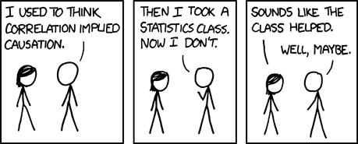
Remember: Correlation Does Not Imply Causation!

Slide 28
Measuring Association Between 2 Variables in a Correlational Study
The way to measure the association between two variables depends on what kinds of variables we’re dealing with
If we’re dealing with two continuous variables: Pearson correlation
If we’re dealing with two categorical variables: Chi-square test
If we’re dealing with a continuous variable and a binary variable: Independent samples t-test
Are the means in the two groups different?
If we’re dealing with a continuous variable and a categorical variable with more than 2 categories: ANOVA
Are the means in the 3+ groups different?

Slide 29
Exploratory Analysis
 |  | Variable 2
 |  | Continuous (Normal) | Continuous (Skewed) | Ordinal | Categorical (3+ categories) | Binary
Variable 1 | Continuous (Normal) | Pearson Correlation
 | Continuous (Skewed) | Spearman Correlation Some will use Pearson Correlation | Spearman Correlation Some will use Pearson Correlation
 | Ordinal | ANOVA (if ordinal variable has only a few categories); Spearman Correlation (if ordinal variable has a lot of categories) | Kruskal-Wallis Test (Non-Parametric ANOVA) (if ordinal variable has only a few categories) Spearman Correlation (if ordinal variable has a lot of categories) | Chi-Square (if variables have a few categories) Spearman correlation (if both variables have a lot of categories)
 | Categorical (3+ categories) | ANOVA | Kruskal-Wallis Test (Non-Parametric ANOVA) | Chi-Square Test | Chi-Square Test
 | Binary | T-Test | Mann–Whitney U test (also called the Mann–Whitney–Wilcoxon (MWW), Wilcoxon rank-sum test (WRS), or Wilcoxon–Mann–Whitney test) | Chi-Square Test | Chi-Square Test | Chi-Square Test Fisher's Exact Test

Slide 30
Coming up with Comparison Groups
In certain situations, you really need a comparison group - results without one might be not particularly meaningful or interesting
Imagine a situation where you have a data set with a lot of individuals who participated in a treatment program and a lot of individuals who didn’t
You can come up with a comparison group using matching
Matching is a statistical technique which is used to evaluate the effect of a treatment by comparing the treated and the non-treated units in an observational or quasi-experimental study.
The goal of matching is, for every treated observation, to find one (or more) non-treated observation(s) with similar observable characteristics against whom the effect of the treatment can be assessed.
By matching treated observations to similar non-treated observations, matching enables a comparison of outcomes among treated and non-treated units to estimate the effect of the treatment reducing bias due to confounding.
Source: Taken almost verbatim from https://en.wikipedia.org/wiki/Matching_(statistics)

Slide 31
Matching Example
Imagine you’re doing a study that looks at how greening vacant lots is associated with neighborhood crime
You have a large data set of, say, 5000 vacant lots, and let’s say 300 of them have been “greened”
For each lot, you have neighborhood crime variables after greening (no pre-greening crime data are available)
To look at impact of greening, it would be very helpful to know what neighborhood crime is for similar lots that were not greened.
So for each greened lot we might want to find 1 or more “matched” ungreened lot that is similar to it on a bunch of different characteristics (e.g., lot size, the amount of time it has been vacant, number of vacant lots nearby, price for which it last sold, etc.).
This way we can compare the greened lots and unmatched greened lots in terms of crime: we are comparing comparable observations.
Statistical matching helps alleviate some concerns about confounding, but is still far from the gold standard of a randomized controlled trial when it comes to trying to establish causality
Propensity score matching (PSM) is a quasi-experimental method in which the researcher uses statistical techniques to construct an artificial control group by matching each treated unit with a non-treated unit of similar characteristics.
Source: https://dimewiki.worldbank.org/wiki/Propensity_Score_Matching#:~:text=Propensity%20score%20matching%20(PSM)%20is,the%20impact%20of%20an%20intervention

Slide 32
An Example of a Geographical Comparison Group
Metraux, Brusilovskiy, Prvu-Bettger, Wong & Salzer (2012): Geographic access to and availability of community resources for persons diagnosed with severe mental illness in Philadelphia, USA
We wanted to look at distance to and number of community resources (e.g., stores, places of worship, restaurants, etc.) for individuals with serious mental illnesses
We had data of 15,246 individuals who received Medicaid services for schizophrenia, schizoaffective disorder, major depression or bipolar disorder
The problem would be much more interesting if we compared access and availability of community resources for people with a serious mental illness and the general population
That is, how much farther do people with serious mental illnesses live from supermarkets than members of the general population?
Cannot infer causality here
We didn’t have a comparison group, but we created one

Slide 33
Creating a Geographical Comparison Group
Took a block group-level shapefile of Philadelphia containing the population variable
Created a comparison group of 15,246 points (same as the number of individuals with serious mental illnesses) which represented the general population
The points were placed randomly, but the number of points in each block group was proportional to the block group’s population.
We also constrained the point placement in a way that they fell along a road network.
This is similar too using the Create Spatially Balanced Points Tool that we would use to create point patterns for the nonhomogeneous (i.e., population adjusted) K-Functions.
With this comparison group, we could compare access and availability of resources for our sample of individuals with serious mental illnesses and points representative of the general population
Same approach was used in another study
Byrne, Prvu-Bettger, Brusilovskiy, Wong, Metraux & Salzer (2013): Comparing Neighborhoods of Adults with Serious Mental Illnesses and of the General Population: Research Implications

Slide 34
Power Analysis
Remember that in statistics there are 2 types of error: Type I error, which means incorrectly rejecting the null hypothesis when it’s true, and Type II error, which means incorrectly failing to reject the null hypothesis when it’s false.
Remember also that the probability of a type I error is referred to as α, and statisticians typically set it at 0.05. That is, most statisticians run a test, compute the p-value, and then compare it to α = 0.05.
Further, recall that for any statistical test carried out on a given sample of size n, α and β will be inversely related, and the only way to decrease both is to increase the sample size.
Typically, statisticians talk about the statistical power of a test, which is related to β.
Power = 1 – Probability(Type II Error) = 1 – β
Power of any test is the probability that it will reject a false null hypothesis
A certain power, type I error, and sample size correspond to the effect size that a statistical test is able to detect.
The measure of effect size is different for each type of statistical analysis. For instance, in Pearson correlations, the effect size is r; in regression analysis, it might be the standardized Beta coefficient, etc.
The larger the sample size, the smaller (better) the effect that’s detectable by the test.

Slide 35
Power Analysis (Cont’d)
For each type of statistical analysis (correlations, t-tests, ANOVAs, regression, etc), there’s a separate method for doing power analysis; sometimes the method is very confusing and poorly documented
In most instances, the method tells you the sample size that you need in order to detect a desirable effect size for a given power level and type I error (typically set at 0.80 and 0.05, respectively)
Because these analyses are often done before collecting the data, you need to guess what effect size you would like to detect
Sometimes you can find what the effect size should be in the literature, and for some tests (e.g., t-tests) there’s good documentation of what is a small, medium and large effect
However, a lot of the time it’s guessing on the part of the researcher, especially in situations when we plan to use more advanced statistical methods for analyzing data
Software: G*Power (free), can be downloaded here: http://www.gpower.hhu.de/en.html
References:
Ellis, P. D. (2010). The essential guide to effect sizes: Statistical power, meta-analysis, and the interpretation of research results. Cambridge University Press.
Cohen, J. (1988). Statistical power analysis for the behavioral sciences (2nd ed). Hillsdale, NJ: Erlbaum.

Slide 36
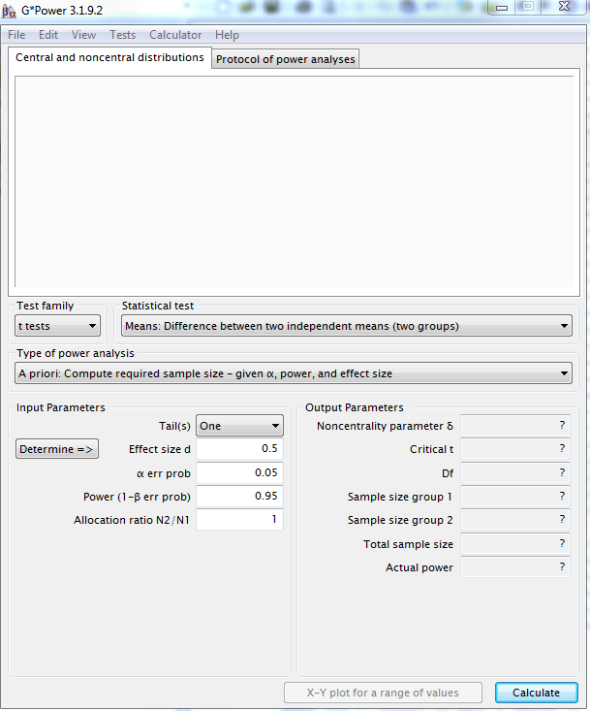
G*Power
Power analysis available for many different types of statistical tests
Each statistical test has its own quirks and parameters when it comes to power analysis

Slide 37
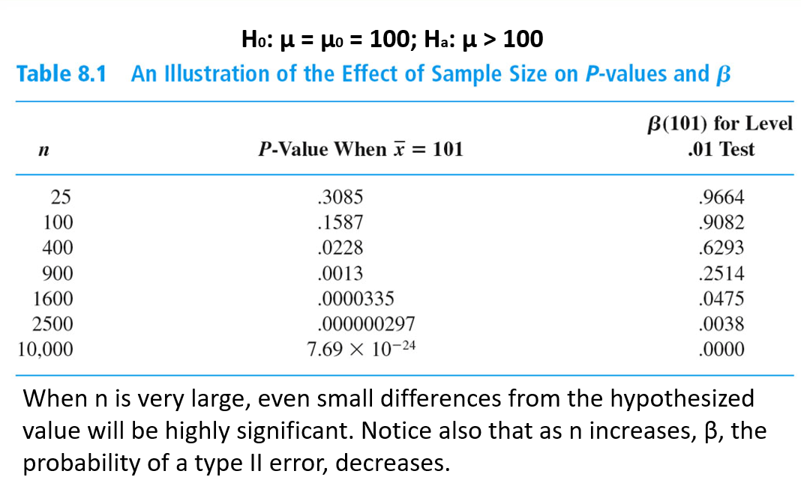

Slide 38
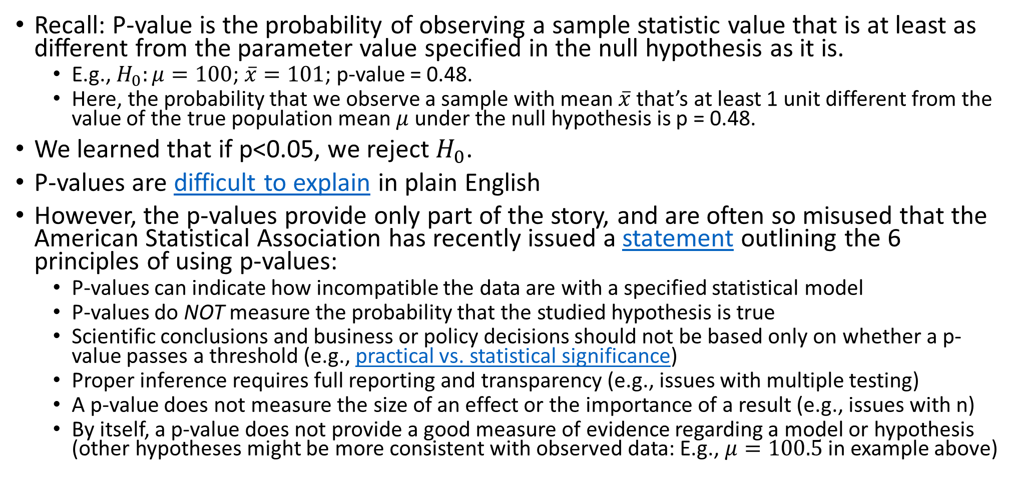
Issues Related to Significance Testing and P-Values
Recall: P-value is the probability of observing a sample statistic value that is at least as different from the parameter value specified in the null hypothesis as it is.
E.g., $H_{0}:μ=100$; $\overline{x}=101$; p-value = 0.48.
Here, the probability that we observe a sample with mean $\overline{x}$ that’s at least 1 unit different from the value of the true population mean $μ$under the null hypothesis is p = 0.48.
We learned that if p<0.05, we reject $H_{0}$.
P-values are difficult to explain in plain English
However, the p-values provide only part of the story, and are often so misused that the American Statistical Association has recently issued a statement outlining the 6 principles of using p-values:
P-values can indicate how incompatible the data are with a specified statistical model
P-values do NOT measure the probability that the studied hypothesis is true
Scientific conclusions and business or policy decisions should not be based only on whether a p-value passes a threshold (e.g., practical vs. statistical significance)
Proper inference requires full reporting and transparency (e.g., issues with multiple testing)
A p-value does not measure the size of an effect or the importance of a result (e.g., issues with n)
By itself, a p-value does not provide a good measure of evidence regarding a model or hypothesis (other hypotheses might be more consistent with observed data: E.g., $μ=100.5$ in example above)

Slide 39
Some General Issues in Research (Many More Exist)
Appropriate sample size
Replicability
Scientists replicated 100 psychology studies and fewer than half got the same results
See https://www.smithsonianmag.com/science-nature/scientists-replicated-100-psychology-studies-and-fewer-half-got-same-results-180956426/
Also see https://blogs.scientificamerican.com/observations/are-scientists-doing-too-much-research/?inf_contact_key=e6947dc58421ecbdab8c92a70f345d494caad13d6c5cad99b18a4c750f2d9001
Discuss: Vaccines Cause Autism study in the Lancet
Generalizability
Representativeness of sample
Inference
Extrapolation
Ecological fallacy vs. atomistic fallacy
If a relationship holds true for groups, it doesn’t mean it holds for individuals that comprise these groups, and vice versa
Appropriate measurement
Validity and reliability of measurement instruments
Theoretical plausibility
Results need to make logical sense

Slide 40

https://www.businessinsider.co.za/boring-jobs-hobbies-profession-personal-traits-scientists-study-2022-3;
https://journals.sagepub.com/doi/10.1177/01461672221079104

Slide 41
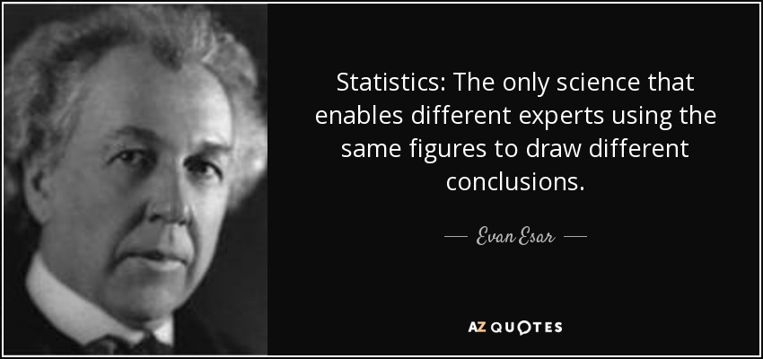
Some Takeaways
None of the regression methods that we’ve seen in the class should be used to establish causality
All hypothesis tests come with 2 types of error, and relationships that you find might be spurious!
https://www.tylervigen.com/spurious-correlations
Statistical significance (or the lack thereof) isn’t everything. The findings need to be practically/clinically significant as well in order to be important.
When dealing with larger sample sizes, even small differences will become significant; when dealing with smaller sample sizes, even large differences may not be.
Statistics is an art as much as it is a science.

Slide 42
Bibliography
I am grateful to the following cites for providing some of the necessary information for this presentation:
http://libguides.usc.edu/content.php?pid=83009&sid=818072
http://www.socialresearchmethods.net/

